Slide 1

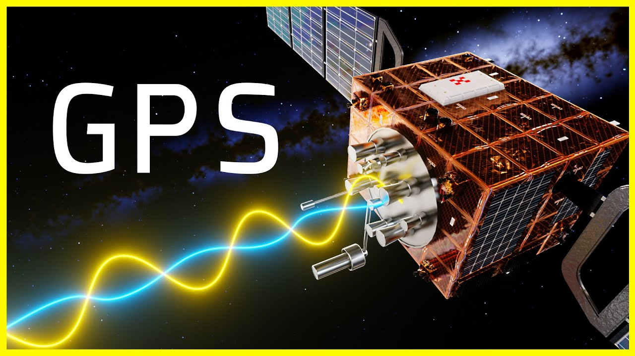
GPS: The Global Positioning System
Fatima al-heji
ECE 4971 Capstone ii

Slide 2
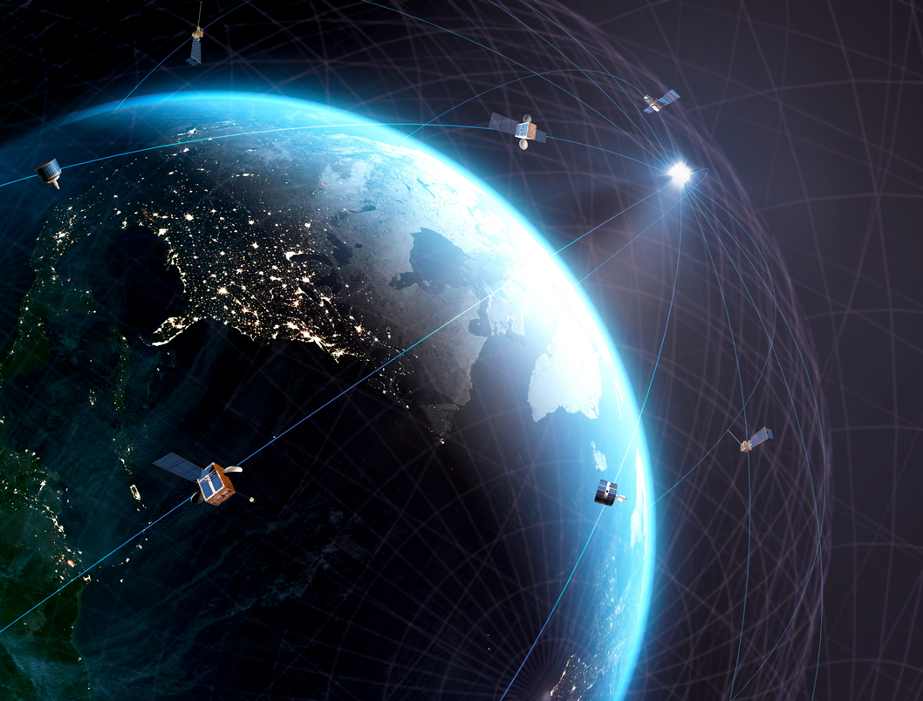
Content:
What is GPS?
The History of GPS
How it works?
What Is Trilateration?
How accurate is GPS?
Sources of GPS signal errors
Circuit Design
Applications

Slide 3

What is GPS?
“The Global Positioning System (GPS) is a U.S.-owned utility that provides users with positioning, navigation, and timing (PNT) services.
This system consists of three segments:
1- the space segment,
2- the control segment
3- the user segment.
The U.S. Space Force develops, maintains, and operates the space and control segments”
From gps.gov

Slide 4
What is GPS?
The GPS system consists of three segments:
1- The Space Segment
The Space Segment of GPS consists of both the satellites and the signals they transmit.
The Space Segment of GPS is made up of a group of spacecraft, known as a constellation, and the signals they broadcast. These signals enable users to calculate their position, velocity, and time

Slide 5
What is GPS?
The GPS system consists of three segments:
2- the control segment
The Control Segment, also known as the Operational Control System (OCS), has the following components:
    Master Control Station in Colorado
    Five monitor stations with atomic clocks located globally near the equator
    Three ground control stations for transmitting information to the satellites

Slide 6
What is GPS?
The GPS system consists of three segments:
3- the user segment.
Satellite signals take around 67 milliseconds to reach a receiver.
The time it takes for signals to arrive depends on the distance between satellites and the user.
In the receiver, four signals are generated to match the structure of the received signals.
By synchronizing these receiver-generated signals with the satellite signals, the time differences between them are measured.
These time differences serve as a timing mark for various calculations.

Slide 7
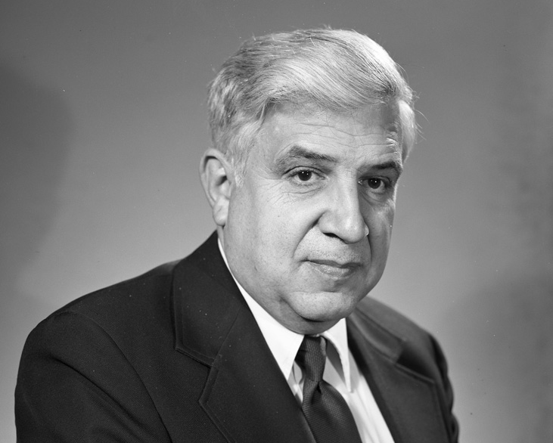
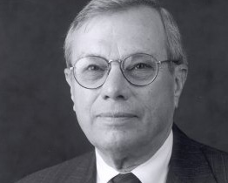
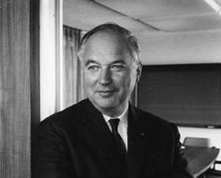
The History of GPS
- GPS development started with the US Department of Defense's idea to use satellites for precise positioning.
- Key contributors like Dr. Ivan Getting, Dr. Bradford Parkinson, and Dr. Roger L. Easton played important roles in making GPS a reality.
- The first GPS satellite launched in 1978, and by 1995, the system became fully operational
Dr. Roger L. Easton
Dr. Bradford Parkinson
Dr. Ivan Getting

Slide 8
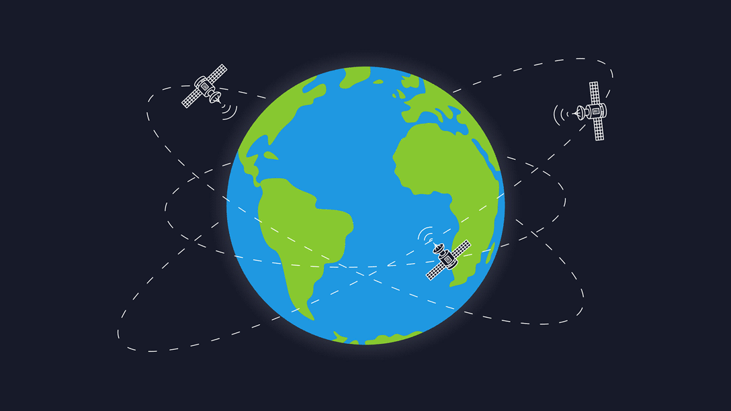
How It Works?
- GPS receivers detect signals from at least 4 GPS satellites and other systems.
- Signals carry information about satellite position and time.
- By measuring signal travel time, distance between satellites and receiver is calculated.
- Trilateration and signals from 3 satellites determine receiver's position in 2D or 3D.
- Basic GPS service provides 7-meter accuracy, 95% of the time.
- Satellites have precise atomic clocks and send data for accurate positioning.
- Receivers compare signal reception and broadcast times, considering atmospheric delays.
- Measurements from at least 4 satellites determine 3D position.
- Fourth satellite measurement can replace need for atomic clock.

Slide 9
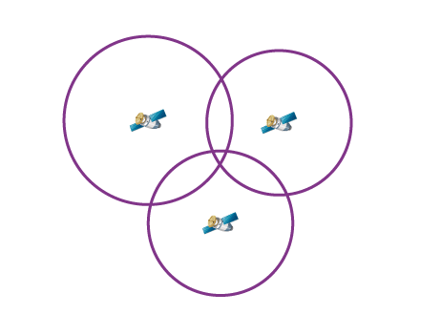
What Is Trilateration?
Trilateration is a method that uses intersecting spheres to determine a location.
It calculates the distance between a GPS satellite and a receiver.
The satellite is at the center of a sphere, and the receiver's distance is determined.
By using this method with three GPS satellites, distances to each satellite are calculated.
Trilateration helps determine parameters like sunrise and sunset times, speed, and receiver-to-destination distance.

Slide 10
How accurate is GPS?
GPS receivers are accurate due to their parallel channel design.
Parallel channels work quickly and precisely to determine location.
Atmospheric noise can occasionally affect GPS receiver accuracy.
Users can enhance precision with Differential GPS (DGPS).
DGPS corrects GPS signals to within a few meters.
The U.S. Coast Guard operates the most common DGPS correction service.
DGPS utilizes towers to receive GPS signals and transmit accurate corrections.

Slide 11
Sources of GPS signal errors:
Factors that can reduce GPS accuracy
Atmospheric delays: Signal slowdown as it passes through the atmosphere.
Signal bouncing: Reflection of the signal off buildings, leading to longer travel time and errors.
Satellite position errors: Mistakes in determining the precise location of GPS satellites.

Slide 12
Electrical Circuits in GPS Receivers
GPS receivers, the RF (Radio Frequency) circuit is a crucial component that plays a vital role in signal reception and processing. It consists of the following key circuits:
  Antenna
  RF Front-End
  Mixer
  IF Filtering

Slide 13
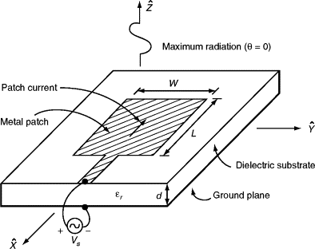
Antenna
- GPS antenna captures and enhances radio signals from GNSS satellites.
- It converts the signals into an electronic form for the GPS receiver.
- The receiver analyzes the antenna's output to calculate the position.
The most commonly used antenna in GPS is the microstrip antenna.

Slide 14
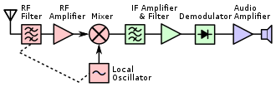
RF Front-End Circuit
The RF front end is the circuitry in a radio receiver between the antenna input and the mixer stage.
It processes the original RF signal before converting it to a lower intermediate frequency (IF).
In microwave and satellite receivers, it may be called a low-noise block downconverter (LNB).
The LNB is often located at the antenna to transfer the signal to the rest of the receiver at a more manageable intermediate frequency.

Slide 15
superheterodyne receiver
In a superheterodyne receiver, the RF front end consists of:
1. RF amplifier or LNA to amplify weak signals without adding noise.
2. Local oscillator (LO) to generate a slightly different frequency signal.
3. Mixer to combine the incoming signal with the LO signal and convert it to an Intermediate frequency (IF).

Slide 16
Definitions
RF amplifier or LNA
  A low-noise amplifier (LNA) amplifies weak signals without adding excessive noise.
  LNAs are designed to minimize additional noise during amplification.
  Special components and circuit designs are used to achieve this noise reduction.
  The objective is to strike a balance between noise reduction, power gain, and impedance matching.
Intermediate frequency (IF)
  - Intermediate frequency (IF) is the frequency to which the carrier wave is shifted during transmission or reception.
  - Superheterodyne receivers use an IF for amplification before final detection.
  - Shifting the signal to an IF simplifies signal processing in the receiver.

Slide 17
Definitions
Mixer
  Mixers combine two signals to create new frequencies.
  They produce signals at the sum and difference of the input frequencies.
  Mixers are used to shift signals from one frequency range to another (heterodyning).
  They are commonly used in superheterodyne receivers to convert signals to a common intermediate frequency.
Local oscillator (LO)
  A local oscillator (LO) changes the frequency of a signal in electronics.
  It works with a mixer and uses a process called heterodyning to create new frequencies.
  By adding or subtracting the LO frequency from the input signal frequency, new frequencies are produced.
  Using a fixed frequency for processing can enhance the performance of a radio receiver.

Slide 18
GPS applications include:
Astronomy: GPS is used for calculations related to astrometry and celestial mechanics.
Automated vehicles: GPS helps driverless vehicles determine their locations.
Cellular telephony: GPS is integrated into mobile phones, allowing users to know their positions, find nearby amenities, and aid in emergency call detection.
Car tracking: GPS enables easy tracking of vehicle locations.
Geo-fencing: GPS is used to track and update the position of humans, animals, or vehicles within a designated area.

Slide 19
Resources:
https://www.gps.gov/systems/gps/
https://www.onestopgis.com/Remote-Sensing/Ground-Truth-Data-and-GPS/Global-Navigation-Satellite-Systems/5-GPS-System-Elements.html
https://www.faa.gov/about/office_org/headquarters_offices/ato/service_units/techops/navservices/gnss/gps/howitworks
https://byjus.com/physics/what-is-gps-global-positioning-system/#components-of-a-gps-system
https://circuitdigest.com/article/what-is-gps
https://novatel.com/products/gps-gnss-antennas
https://en.wikipedia.org/wiki/Low-noise_amplifier
https://geoawesomeness.com/eo-hub/who-invented-the-gps/
https://www.faa.gov/about/office_org/headquarters_offices/ato/service_units/techops/navservices/gnss/gps/howitworks
https://ardupilot.org/copter/docs/common-gps-how-it-works.html
https://www.nh.gov/nhdfl/documents/introduction-to-global-positioning-system.pdf

